Slide 1


Apartment Information System
-: Member Details :-
17 01 04 005 :- Shams Al Hasan
17 01 04 012 :- Shah Alam Tasin
17 01 04 014 :- Tashreef Muhammad
17 01 04 021 :- Arafat Uddin

Slide 2
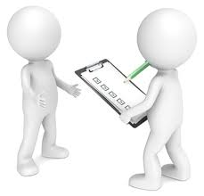

Problem Details
Many jobs that are done manually could be done digitally
Industrial revolution, catalyzes increase of apartment systems for residence system
Government officials go door to door for information
Police collecting verification data
Certified people collecting data in favor of government
Utility fees
Service bills

Slide 3



Motivation
To Help Government:
In verification process
In citizen data collection
In ensuring public security
To Help Apartment Residence:
In billing system till some extent
In securing personal information till some extent
In maintaining outsiders’ information

Slide 4



Solution
Building a database: for an apartment building where the information of each of the apartments are stored of both the current residence and previous residence of that particular apartment.
Storing data: about people who come to the building but do not reside in it and build a log system to be used for later analysis if needed.
Sending warning email: When a pre-paid utility service is about to end or expire.

Slide 5


Solution
Assumptions For Solution:
Entitle a technical person for data handling.
Require apartment complex which consists of around 30 or more apartments
Entitled person can provide bills on behalf of the residence if they allowed
Require pre-paid system and hardwire system to automatically provides data about how much left in the account

Slide 6

Features
For Manager
Can view the balance of residence prepaid account
Can add information of new resident
Deletion of any data is not allowed
Can view some permitted data
Manage restricted filtered search on data

Slide 7


Features
For Security Guard
Can add guest information
Able to see resident data to find where guest is going
For System Administrator
Is capable of controlling all data from core
Is the final lifeline if a problem cannot be solved except direct interference from software backend

Slide 8
Features
For resident
Can see all transactions
Can add comment or instructions for manager
Can report about inconsistency in transactions
Others
Warning through email about prepaid services
Each of the Manger, Security and Resident will have different Graphical User Interfaces

Slide 9
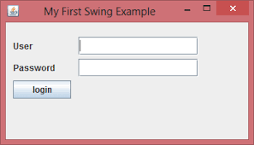


Platform

Slide 10
Any Questions?
Thank You

